Slide 1
Portfolio site
Name:m.sai sudheepa
College:n.b.k.r Institute of science and technology
Batch: fed-batch 1

Slide 2
The technology I used to develop this web page
Html
Css
JavaScript
Bootstrap

Slide 3
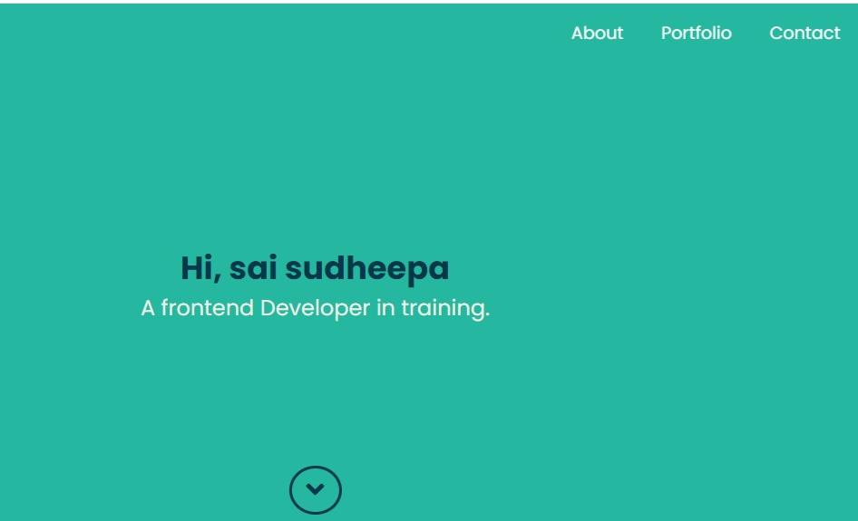

Slide 4
You can access the about,portfolio, contact from the nav bar or from down arrow feautre
After accessing you can move to the about page there you can found my skillS and about me

Slide 5
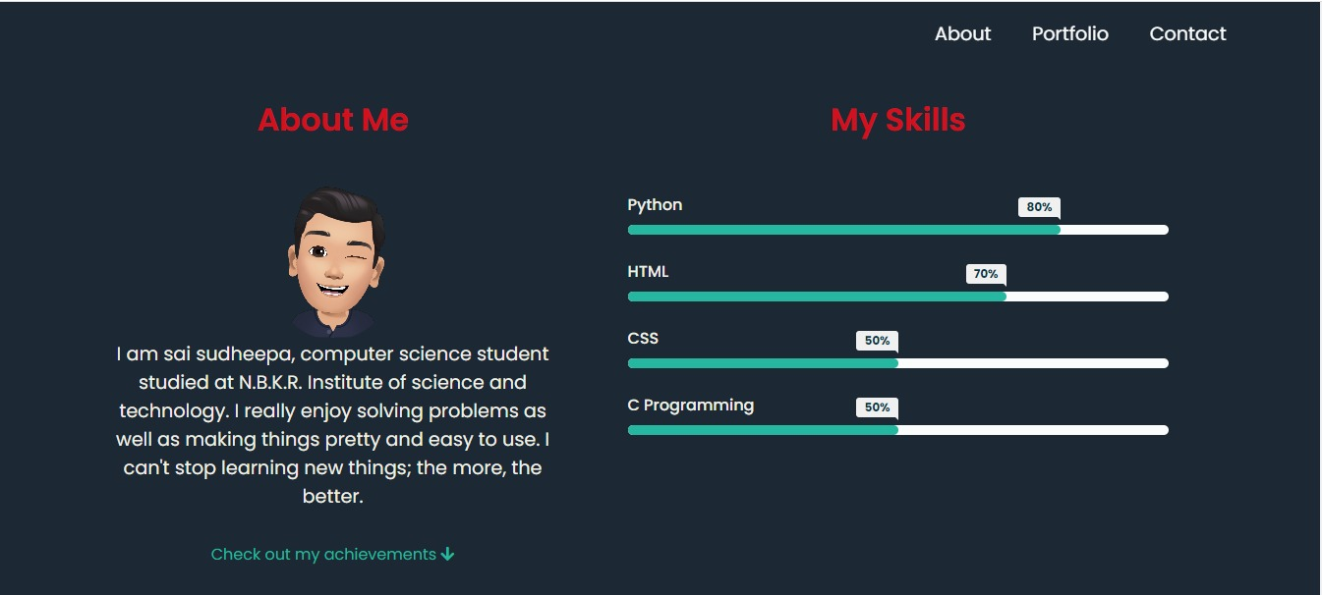
About page

Slide 6
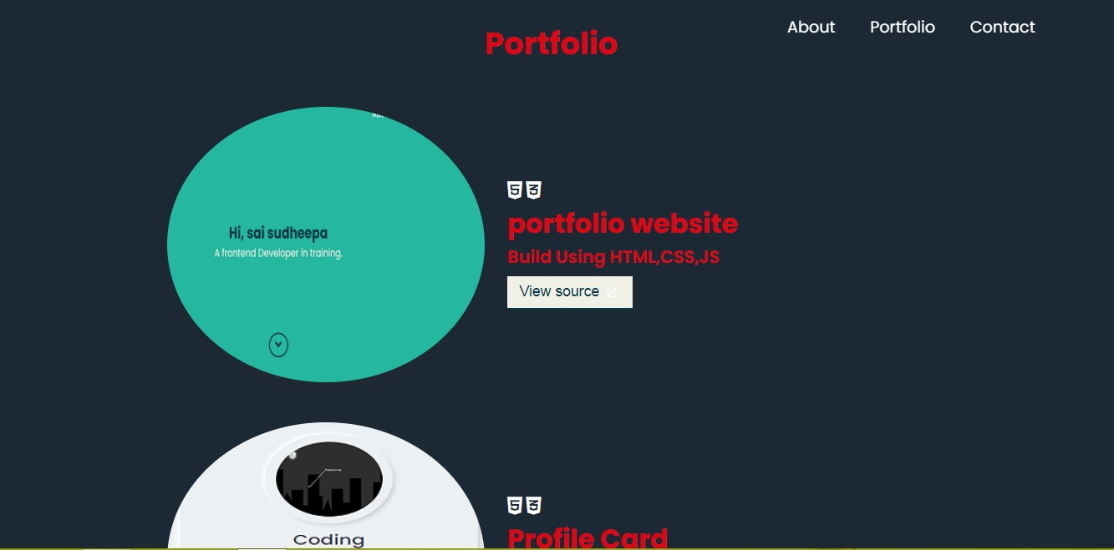
Portfolio page

Slide 7
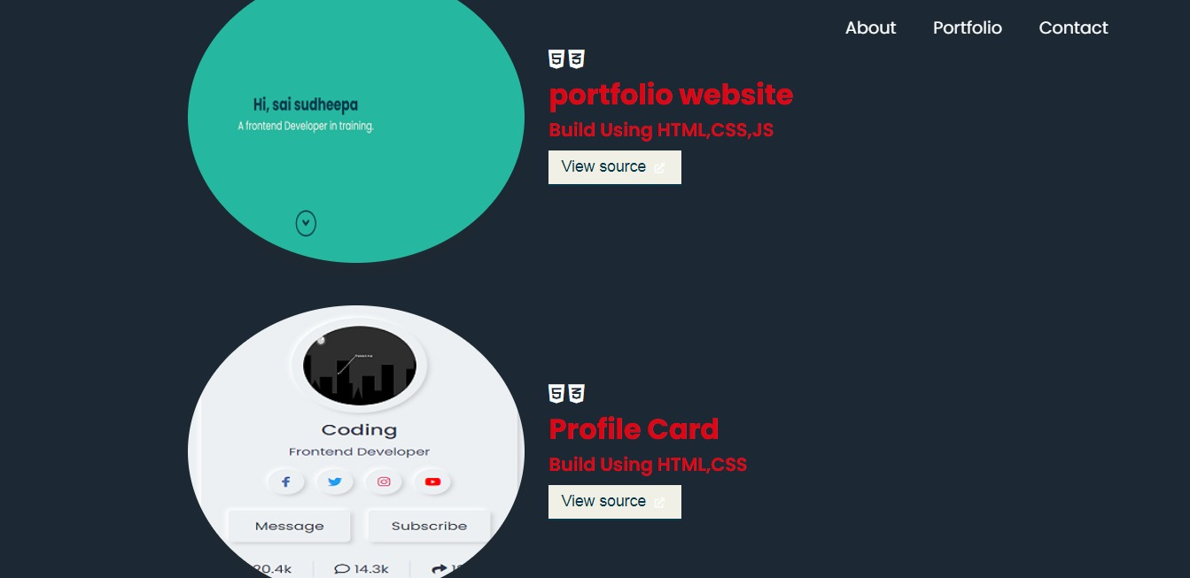
Here you can see my recent projects, when you click view source it will redirect into my github account there you can access the source code of the project

Slide 8
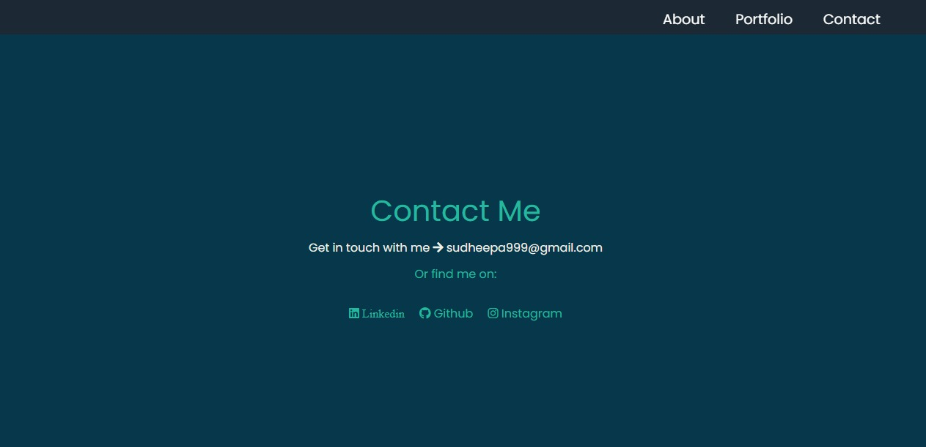
Contact page

Slide 9
In the contact page I provided my Gmail,LinkedIn,github accounts. Through that you can keep in touch with me.
And this is my portfolio web page, which I created according to my knowledge and skills.through this I got more experience in using of vs code and web technologies, and I am very much enthusiastic in doing like this web pages.

Slide 10
Thank you

